Slide 1
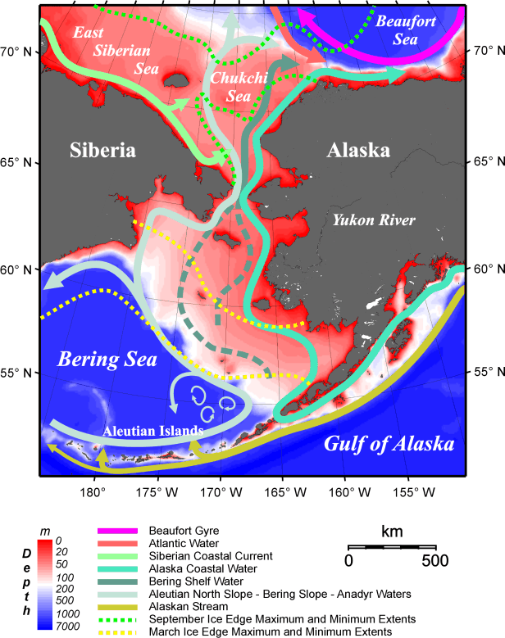
What is unique about the Bering Sea?
Physical
Seasonal ice with advection to the south
Tidal mixing sets up distinct biophysical regimes
Biological
Ice plankton may be a major food source to higher trophic levels
Benthic food chain is a major player

Slide 2
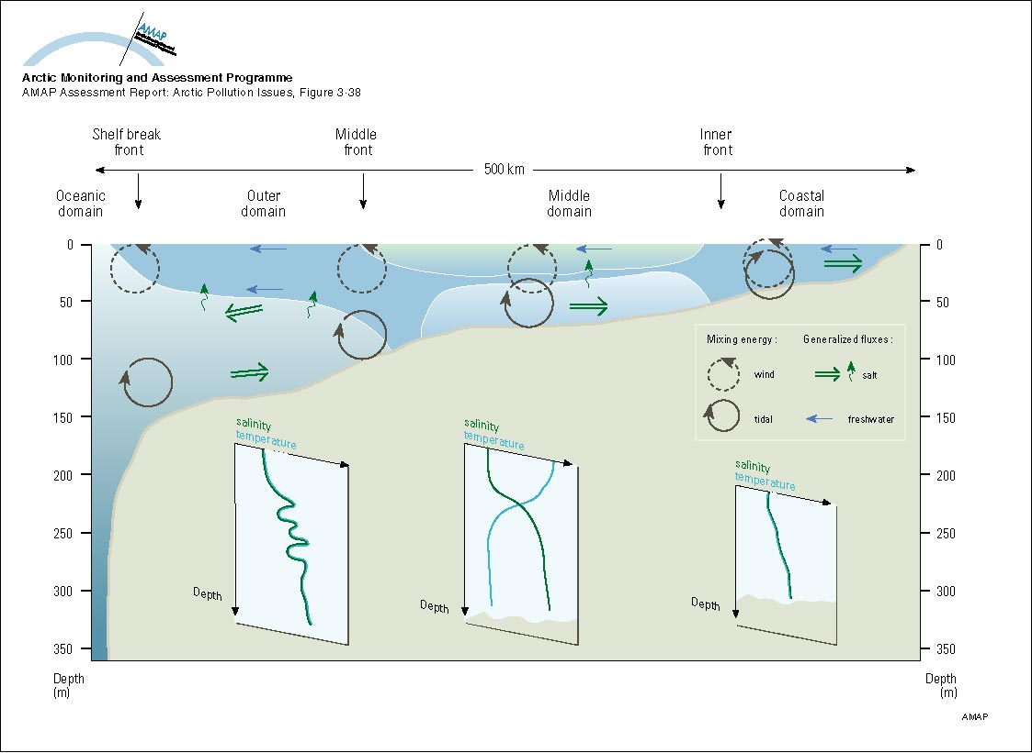
Biophysical domains of the Bering Sea shelf

Slide 3
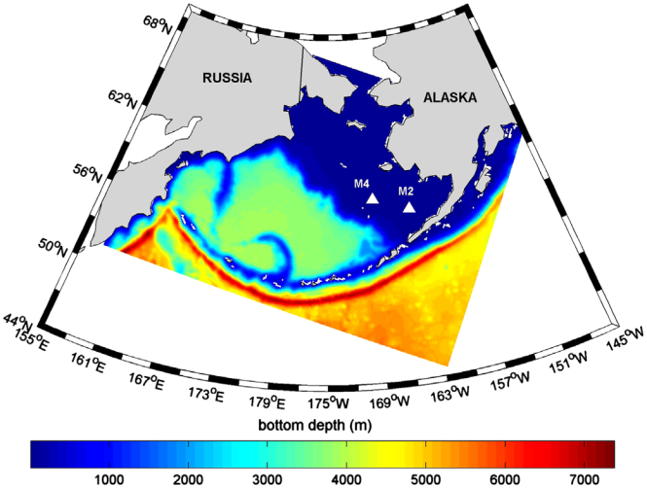
Bering10K model
Regional Ocean Modeling System (ROMS)
Descendent of NEP5 (Danielson et al. 2012)
30 layers, 10-km grid Includes ice and tides
CCSM bulk flux
Details in Kearney et al. (2020) and Hermann et al. (DSR2, 2013, 2016)

Slide 4
Model-based downscaling
hindcasts
generate past regional ocean states using global atmospheric and oceanic reanalyses
results also used to drive spatially-explicit Individual-Based Models
growing database of observations for validation
long-term forecasts
generate future (multi-decadal) regional ocean states using IPCC models as forcing and boundary conditions
seasonal forecasts
generate future (9-month) regional ocean states using NOAA climate forecasts system

Slide 5
Reforecast vs. Reanalysis (hindcast)
DATA
hindcast
Reanalysis (hindcast) simulation assimilates data all the way through
Compare these two
hindcast
reforecast
Reforecast simulation pretends you had NO DATA beyond some date

Slide 6
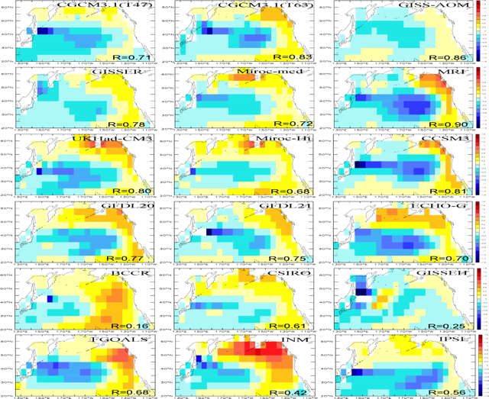

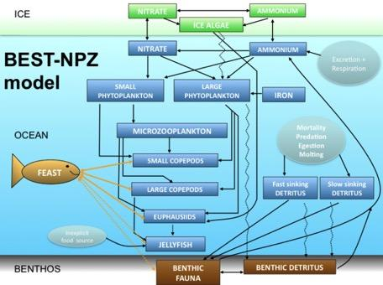
Climate models
provide BCs/ICs to
regional coupled models
Bering10K
ensemble of runs
NPZ
Statistical methods
GOAL: seasonal to mutidecadal projections of physics and biology in the Bering Sea
ensemble of projected futures
MSE
D. Pilcher has added carbonate!

Slide 7
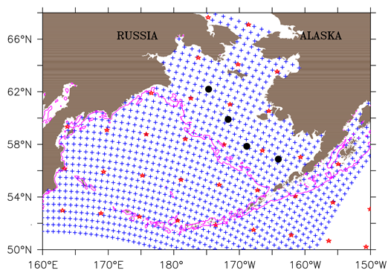
Bering10K grid density (every 5th gridpoint shown)
+ : Bering Sea 10 km
✩: Global model
⚫ : PMEL moorings

Slide 8
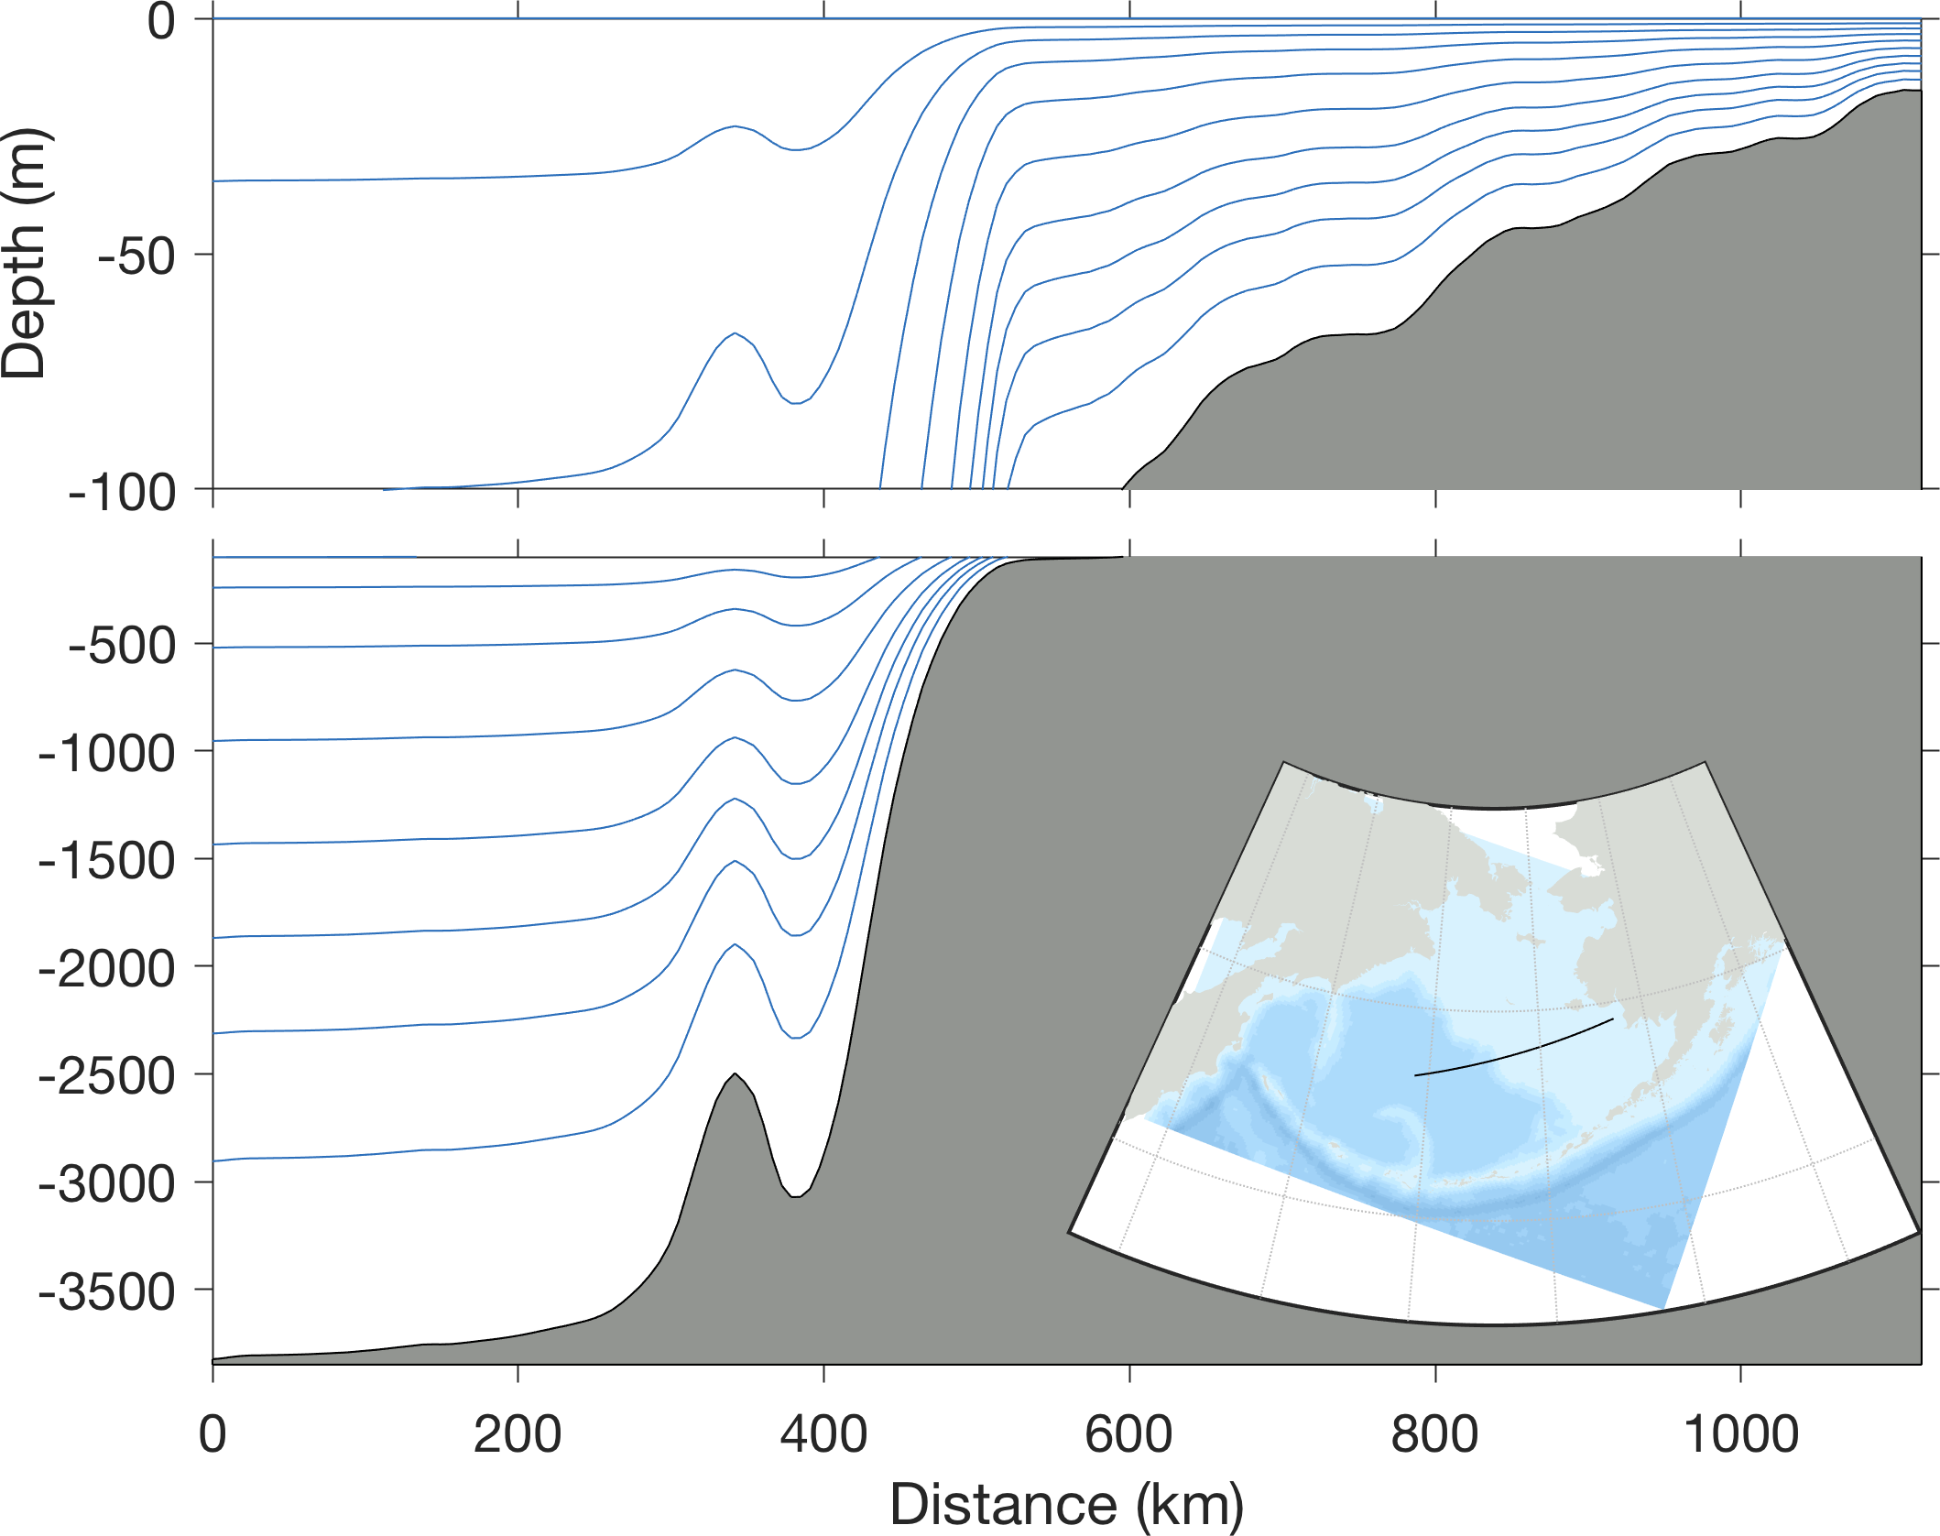
Terrain-following coordinate detail

Slide 9
Initial and Boundary conditions
Interpolate large-scale T,S, SSH fields from the global model to the regional model. Note global ocean hindcasts assimilate data, so regional model is guided by that data.
Allow signals from the regional model to propagate through the boundaries

Slide 10
Primary physical ocean variables
Variable | Symbol | Units
Temperature | T | Deg C
Salinty | S | ppt
Sea Surface Height | SSH | m
Horizontal Velocity | U,V | m/s
Vertical velocity Vertical diffusion | W AKT | m/s m2/s
Ice area Ice thickness | AICE HICE | (fraction) m

Slide 11
Atmospheric forcing variables used (from global, data-assimilating models)
Variable | Symbol | Units
Air Temperature | TAIR | Deg C
SLP | PAIR | mbar
Absolute Humidity | QAIR | kg/kg
Wind velocity | UWIND, VWIND | m/s
Downward longwave radiation | LWRAD_DOWN | W/m^2
Shortwave radiation | SWRAD | W/m^2
These are used to calculate surface momentum flux (wind stress) and surface heat flux

Slide 12
Four types of surface heat flux
Shortwave radiation – i.e. “sunlight” – what you see and feel on a nice day at the beach
Longwave radiation – also felt but not seen – e.g. the radiation from hot coals
Sensible heat flux – warm air molecules collide with and heat up a cold ocean
Latent heat flux – evaporation at the sea surface cools the ocean

Slide 13
Coastal runoff
Can directly input freshwater and momentum at the coast but in coarse models this causes trouble (the runaway estuary problem).
A useful fix is to add runoff at the surface within a near-coastal band.
Salinity is always more difficult to get right than temperature, for this and other reasons.

Slide 14
Ice
Changes the surface fluxes of heat, momentum
Has different dynamics than the fluid; deformation
Ice-albedo feedback at global scales

Slide 15
Forcing uncertainty
Global forecasts have finite skill, limited by observations and model structure
Nature is chaotic so details always elusive
All forecasts have bias. Reforecasting experiments help establish mean bias, which can be subtracted from the forcing

Slide 16
Regional model (Bering10K) uncertainty: a few tuned (or tunable) physical parameters
Bulk flux algorithms (heat/stress flux at surface, based on atmospheric forcing)
Vertical mixing algorithms (based on shear and density gradients in the ocean interior)
Bottom friction
Surface albedo of open water (whitecap effects)
Surface albedo of ice (carbon black, sediment effects)
Horizontal vs vertical ice growth
Plasticity of ice (resistance to deformation)

Slide 17
END OF TALK (extra slides beyond this point)

Slide 18
Bias correction
Bias degrades skill due to nonlinearities
Bias can be added at both large and small scales
Global bias (e.g. CFS) -> regional bias (Bering10K)
Penetration of global bias should be subject to wave, advective, and diffusive dynamics; different rates of penetration for different variables
Emergent regional biases may take time to develop; possibly swamped by the global bias

Slide 19
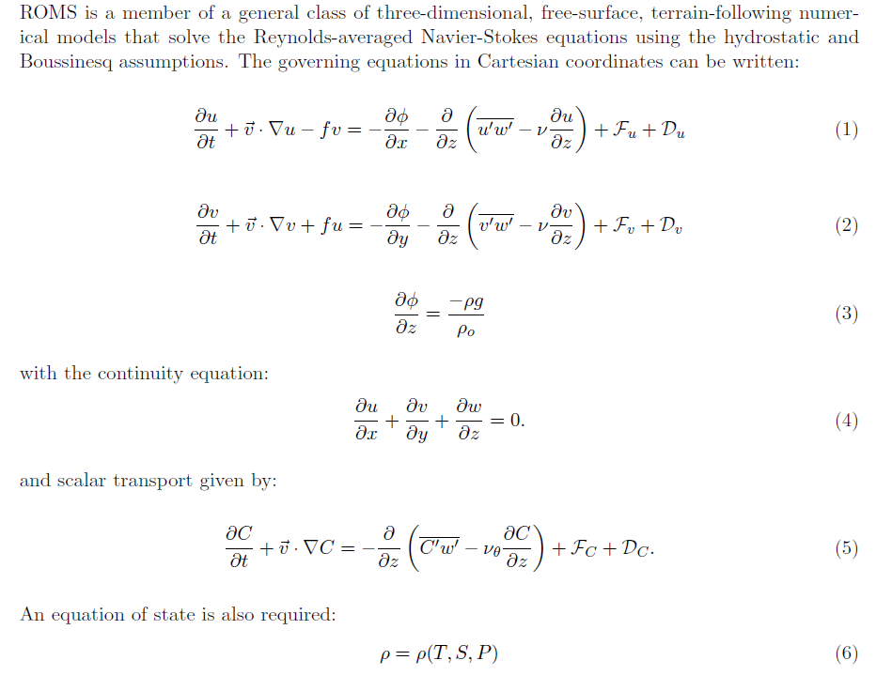
ROMS governing equations

Slide 20
Continuity, scalars, and equation of state

Slide 21
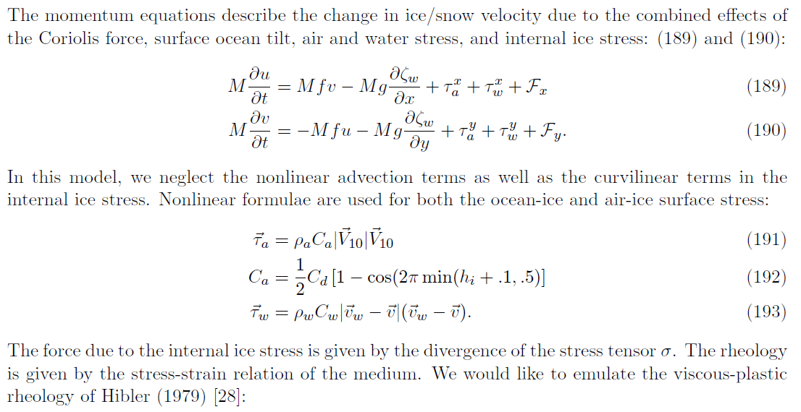
ICE dynamics

Slide 22
ICE
NITRATE
AMMONIUM
ICE ALGAE
Bering10K-NPZ Model
(Gibson and Spitz, 2011)
NITRATE
AMMONIUM
Excretion/ Respiration
SMALL PHYTOPLANKTON
LARGE PHYTOPLANKTON
IRON
Mortality
Predation
Egestion
Molting
OCEAN
MICROZOOPLANKTON
SMALL COPEPODS
FEAST
LARGE COPEPODS
Fast sinking
DETRITUS
Slow sinking
DETRITUS
EUPHAUSIIDS
Inexplicit
food source
JELLYFISH
BENTHOS
BENTHIC FAUNA
BENTHIC DETRITUS
Notes:
Schematic of the BSIERP model as it currently stands.
The BSIERP NPZ model is based on the GOA GLOBEC model developed by Hinckley et al.
The 1D model with the benthic sub model and jellyfish has been run for 1999 and validated with observational data at M2.
The ice sub model is new and not yet tested – based on work by Jin et al.
The calanus is a new zooplankton box. Neocalanus predominate off shelf while calanus predominate on shelf. The main difference is that Calanus DO NOT undergo diapause.
Sticking with only 1 euphausiid for now – Ken doesn’t think we have enough info or model capability to simulate the 2 different species that tend to predominate in the shelf (T. inermis) and offshef (T. raschii) -(as Geroge Hunt wanted)

